Slide 1
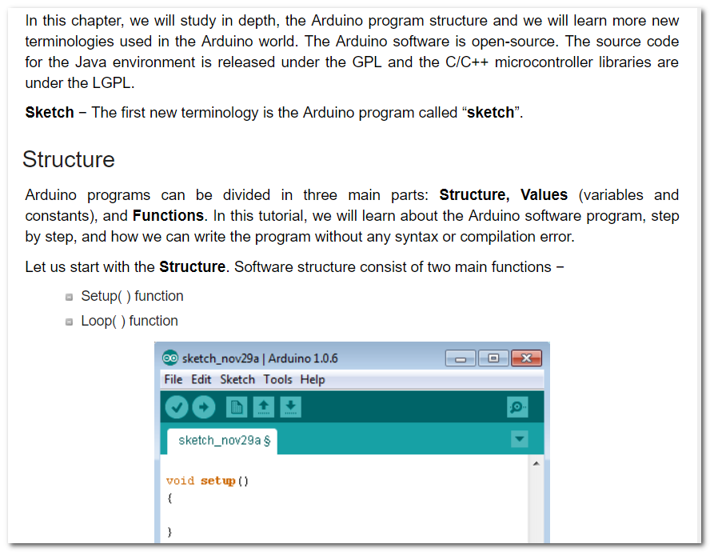

Slide 2
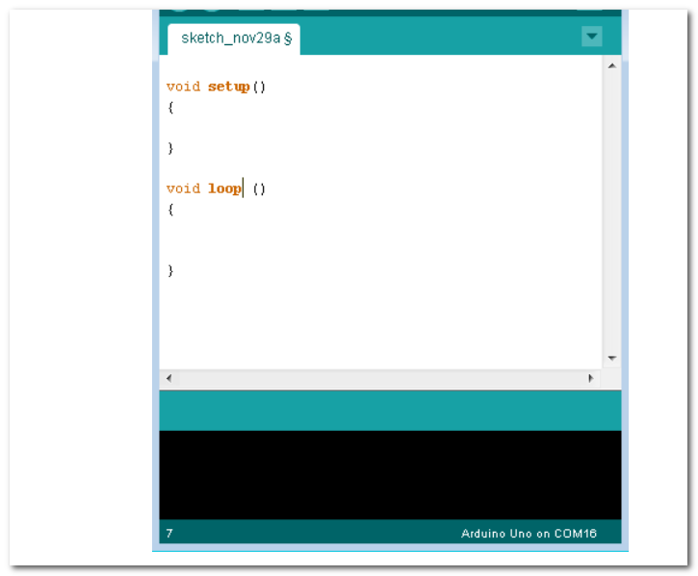

Slide 3
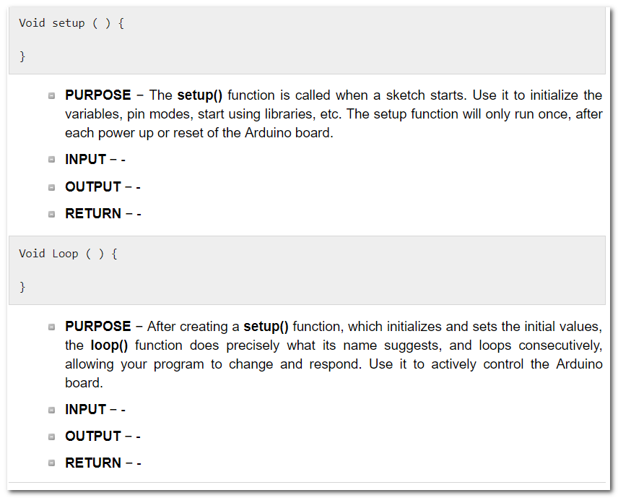

Slide 4
#include <LiquidCrystal.h> const int rs = 12, en = 11, d4 = 5, d5 = 4, d6 = 3, d7 = 2; LiquidCrystal lcd(rs, en, d4, d5, d6, d7); void setup() { lcd.begin(16,2); delay(500); } void loop() { lcd.setCursor(15,0); lcd.print("hello,world!"); // for (int i=0;i<9;i++) //{ // lcd.scrollDisplayLeft(); // delay(250); //} }

Slide 5
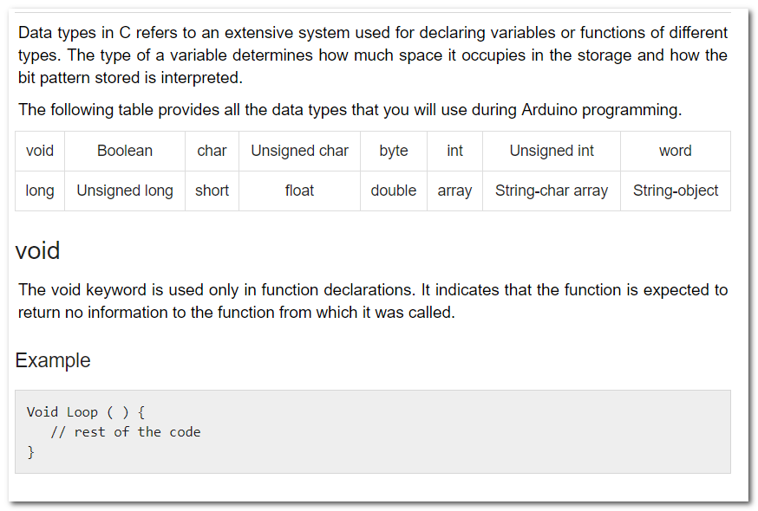

Slide 6
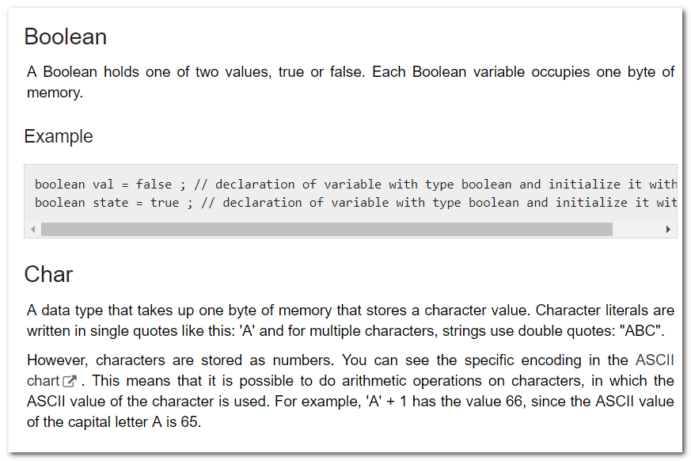

Slide 7
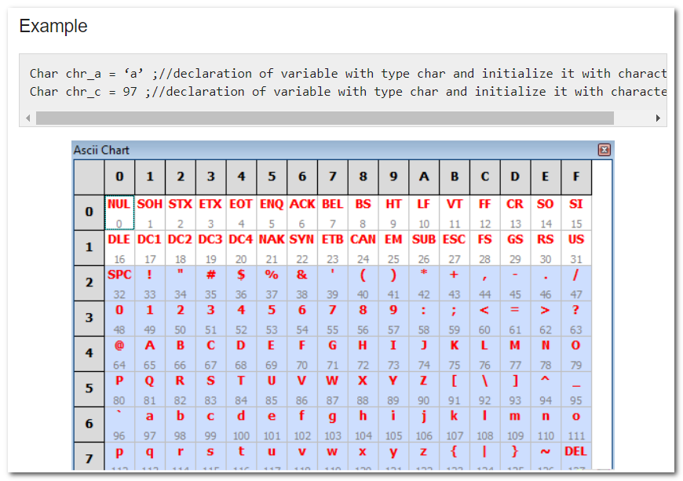

Slide 8
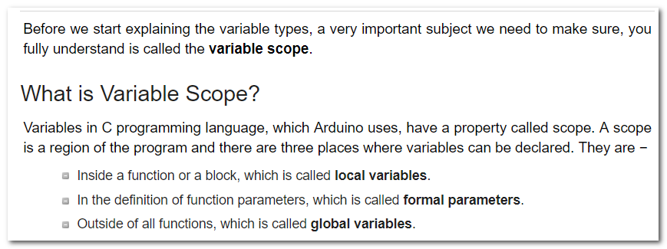
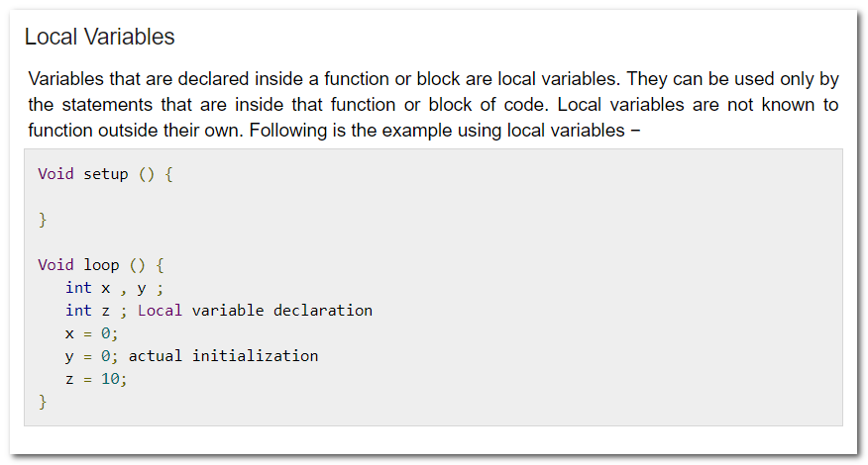

Slide 9
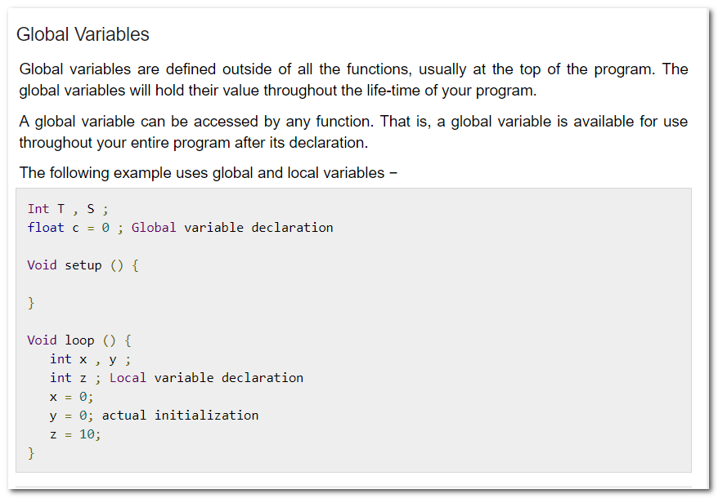

Slide 10
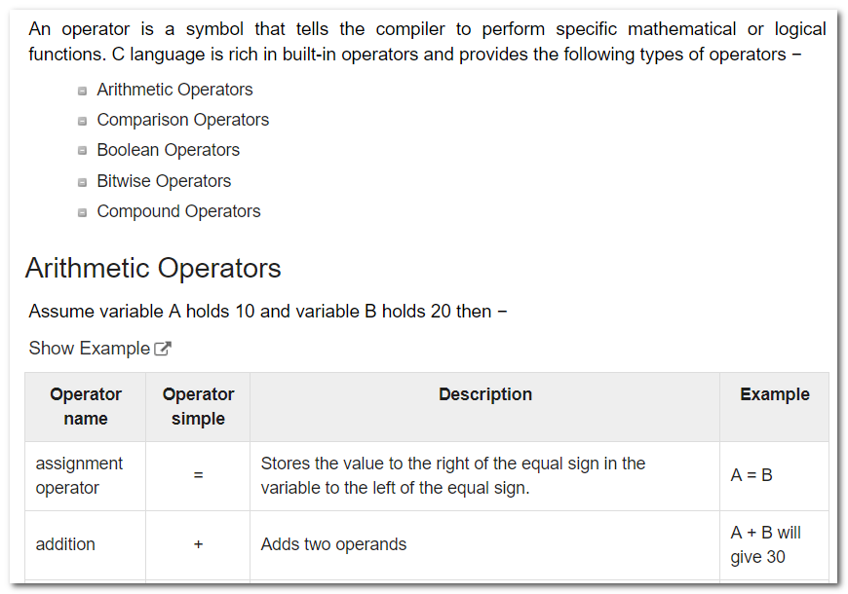

Slide 11
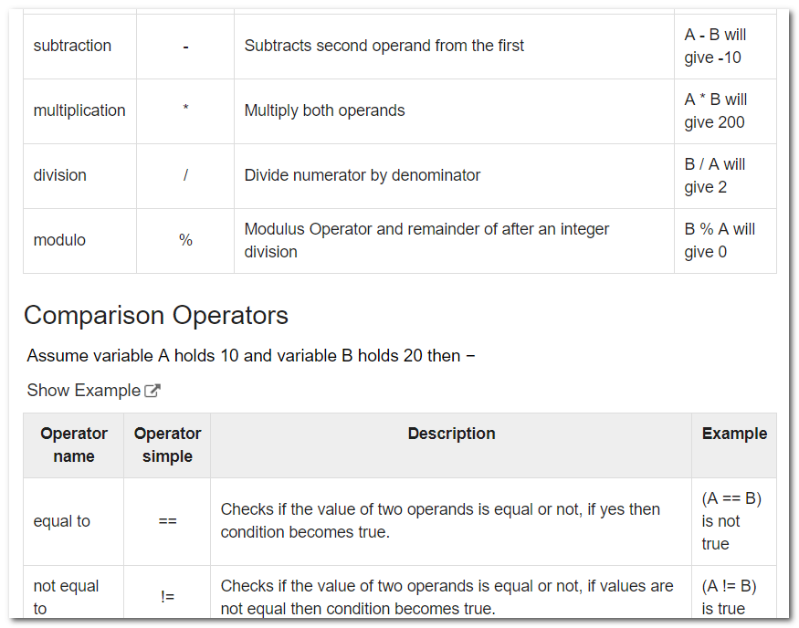

Slide 12
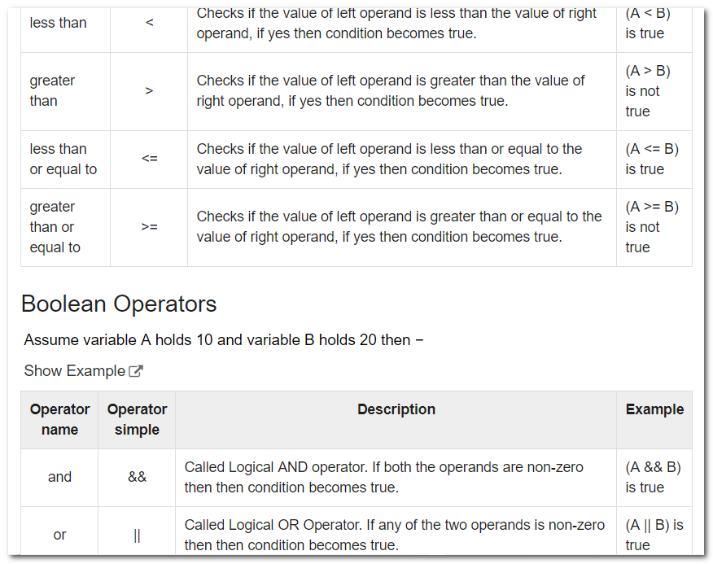

Slide 13
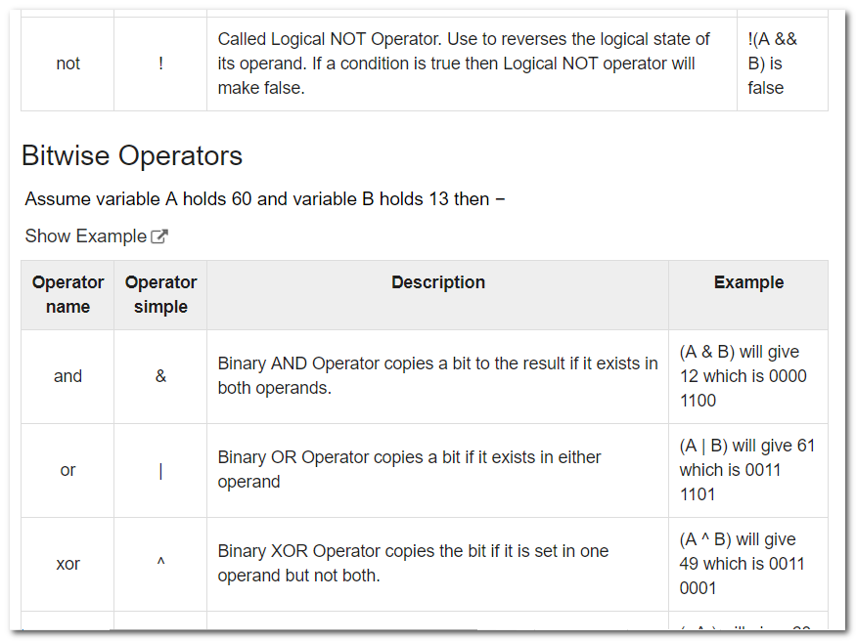

Slide 14
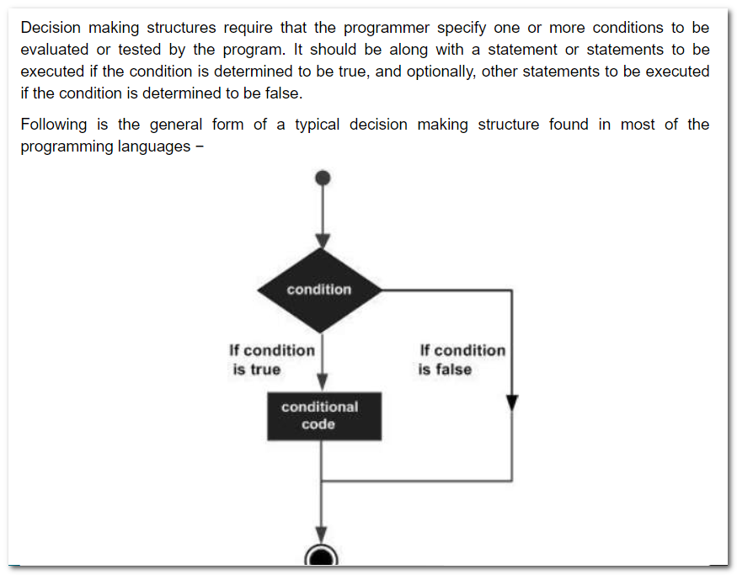

Slide 15
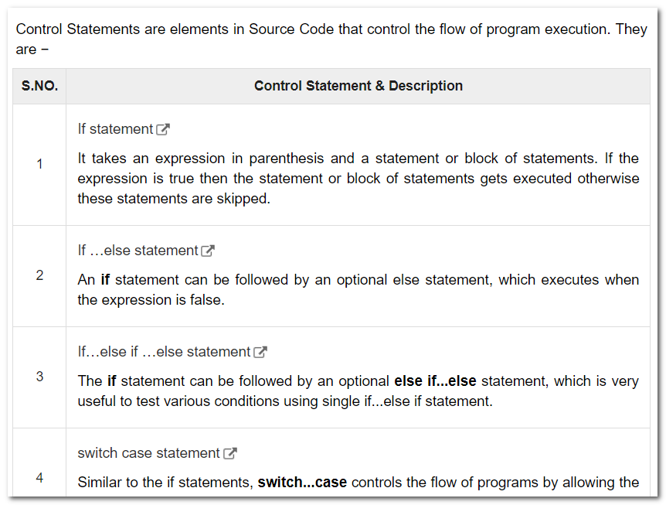

Slide 16
